Slide 1
4DB001 - Database
Week-02, Lecture-02

Slide 2
Introduction to SQL
Anmol Adhikari

Slide 3

What’s in it for you?
Define terms
Interpret history and role of SQL
Define a database using SQL data definition language
Write single table queries using SQL
Establish referential integrity using SQL
Integrity Constraints

Slide 4
1. SQL Overview
Structured Query Language
The standard for relational database management systems (RDBMS)
RDBMS: A database management system that manages data as a collection of tables in which all relationships are represented by common values in related tables

Slide 5
2. History of SQL
1970–E. F. Codd develops relational database concept
1974-1979–System R with Sequel (later SQL) created at IBM Research Lab
1979–Oracle markets first relational DB with SQL
1981 – SQL/DS first available RDBMS system on DOS/VSE
Others followed: INGRES (1981), IDM (1982), DG/SGL (1984), Sybase (1986)
1986–ANSI SQL standard released
1989, 1992, 1999, 2003, 2006, 2008–Major ANSI standard updates
Current–SQL is supported by most major database vendors

Slide 6
3. Purpose of SQL Standard
Specify syntax/semantics for data definition and manipulation
Define data structures and basic operations
Enable portability of database definition and application modules
Specify minimal (level 1) and complete (level 2) standards
Allow for later growth/enhancement to standard (referential integrity, transaction management, user-defined functions, extended join operations, national character sets)

Slide 7
4. Benefits of a Standardized Relational Language
Reduced training costs
Productivity
Application portability
Application longevity
Reduced dependence on a single vendor
Cross-system communication

Slide 8
5. SQL Environment
Catalog
A set of schemas that constitute the description of a database
Schema
The structure that contains descriptions of objects created by a user (base tables, views, constraints)
Data Definition Language (DDL)
Commands that define a database, including creating, altering, and dropping tables and establishing constraints
Data Manipulation Language (DML)
Commands that maintain and query a database
Data Control Language (DCL)
Commands that control a database, including administering privileges and committing data

Slide 9
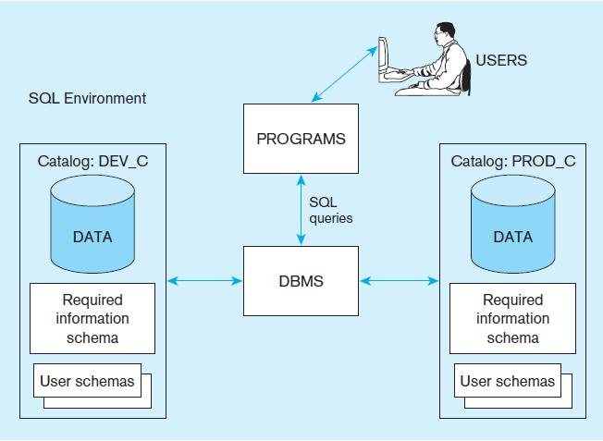
A simplified schematic of a typical SQL environment, as described by the SQL: 2008 standard

Slide 10
6. SQL Data Types
Data Types | Information | Description
String | CHARACTER (CHAR) CHARACTER VARYING (VARCHAR or VARCHAR2) | Stores string values containing any characters in a character set. CHAR is defined to be a fixed length. Stores string values containing any characters in a character set but of definable variable length.
Number | NUMERIC INTEGER (INT) | Stores exact numbers with a defined precision and scale. Stores exact numbers with a predefined precision and scale of zero

Slide 11
6. SQL Data Types(cont..)
Data Types | Information | Description
Temporal | TIMESTAMP TIMESTAMP WITH LOCAL TIME ZONE | Stores a moment an event occurs, using a definable fraction-of-a-second percision. Value adjusted to the user’s session time zone (available in ORACLE and MYSQL)
Boolean | BOOLEAN | Stores truth values: TRUE, FALSE, or UNKNOWN.

Slide 12
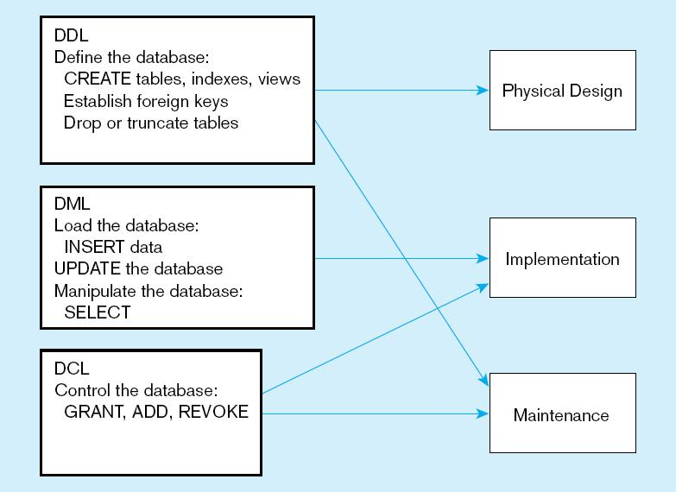
DDL, DML, DCL, and the database development process

Slide 13
7. SQL Database Definition
Data Definition Language (DDL)
Major CREATE statements:
CREATE SCHEMA – defines a portion of the database owned by a particular user
CREATE TABLE – defines a new table and its columns
CREATE VIEW– defines a logical table from one or more tables or views
Other CREATE statements: CHARACTER SET, COLLATION, TRANSLATION, ASSERTION, DOMAIN

Slide 14
7.1. Steps in Table Creation
Identify data types for attributes
Identify columns that can and cannot be null
Identify columns that must be unique (candidate keys)
Identify primary key – foreign key mates
Determine default values
Identify constraints on columns (domain specifications)
Create the table and associated indexes

Slide 15
7.2. Integrity Constraints
Integrity constraints are a set of rules. It is used to maintain the quality of information.
Integrity constraints ensure that the data insertion, updating, and other processes must be performed in such a way that data integrity is not affected.
Thus, integrity constraint is used to guard against accidental damage to the database.
Various Integrity Constraints are:
Check
Not null
Unique
Primary key
Foreign key

Slide 16
7.2. Integrity Constraints(cont..)
Check
This constraint defines a business rule on a column. All the rows in that column must satisfy this rule.
Limits the data values of variables to a specific set, range, or list of values.
The constraint can be applied for a single column or a group of columns.
E.g. value of SPI should be between 0 to 10.
Not null
This constraint ensures all rows in the table contain a definite value for the column which is specified as not null. Which means a null value is not allowed.
E.g. name column should have some value.
Unique
This constraint ensures that a column or a group of columns in each row have a distinct (unique) value.
A column(s) can have a null value but the values cannot be duplicated.
E.g. enrollmentno column should have unique value.

Slide 17
7.2. Integrity Constraints(cont..)
Primary key
This constraint defines a column or combination of columns which uniquely identifies each row in the table.
Primary key = Unique key + Not null
E.g. enrollmentno column should have unique value as well as can’t be null.
Foreign key (referential integrity constraint)
A referential integrity constraint (foreign key) is specified between two tables.
In the referential integrity constraints, if a foreign key column in table 1 refers to the primary key column of table 2, then every value of the foreign key column in table 1 must be null or be available in primary key column of table 2.
Foreign Key
DeptID | Dept_Name | HOD
1 | Computer | Doshi
2 | IT | Vyash
RollNo | Student_Name | DeptID
101 | Raj Patel | 1
102 | Meet Shah | 2

Slide 18
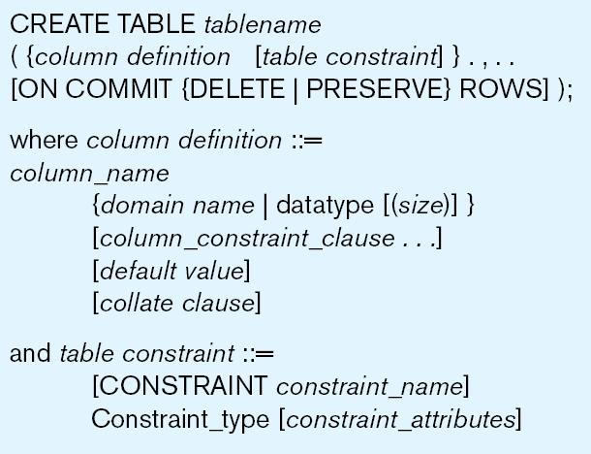
General syntax for CREATE TABLE statement used in data definition language

Slide 19

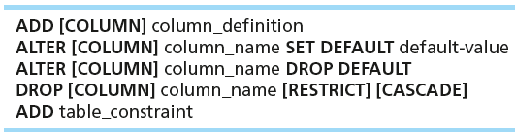

7.3. Changing Tables
ALTER TABLE statement allows you to change column specifications:
Table Actions:
Example (adding a new column with a default value):

Slide 20
7.4. Removing Tables
DROP TABLE statement allows you to remove tables from your schema:
DROP TABLE CUSTOMER_T

Slide 21



7.5. Insert Statement
Adds one or more rows to a table
Inserting into a table
Inserting a record that has some null attributes requires identifying the fields that actually get data
Inserting from another table
21

Slide 22
7.6. Delete Statement
Removes rows from a table
Delete certain rows
DELETE FROM CUSTOMER_T WHERE CUSTOMERSTATE = ‘HI’;
Delete all rows
DELETE FROM CUSTOMER_T;

Slide 23

7.7. Update Statement
Modifies data in existing rows

Slide 24
8. Schema Definition
Control processing/storage efficiency:
Choice of indexes
File organizations for base tables
File organizations for indexes
Data clustering
Statistics maintenance
Creating indexes
Speed up random/sequential access to base table data
Example
CREATE INDEX NAME_IDX ON CUSTOMER_T(CUSTOMERNAME)
This makes an index for the CUSTOMERNAME field of the CUSTOMER_T table

Slide 25
9. Select Statement
Used for queries on single or multiple tables
Clauses of the SELECT statement:
SELECT
List the columns (and expressions) to be returned from the query
FROM
Indicate the table(s) or view(s) from which data will be obtained
WHERE
Indicate the conditions under which a row will be included in the result
GROUP BY
Indicate categorization of results
HAVING
Indicate the conditions under which a category (group) will be included
ORDER BY
Sorts the result according to specified criteria

Slide 26

9.1. Select Example
Find products with standard price less than $275
Operator | Meaning
= | Equal to
> | Greater than
>= | Greater than or equal to
< | Less than
<= | Less than or equal to
<> | Not equal to
!= | Not equal to
Table : Comparison Operators in SQL

Slide 27
9.2. Select example using a Function
Using the COUNT aggregate function to find totals
SELECT COUNT(*) FROM ORDERLINE_T
WHERE ORDERID = 1004;
Note: with aggregate functions you can’t have single-valued columns included in the SELECT clause, unless they are included in the GROUP BY clause.

Slide 28
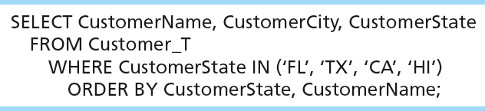
9.3. Sorting results with ORDER BY Clause
Sort the results first by STATE, and within a state by the CUSTOMER NAME
Note: the IN operator in this example allows you to include rows whose CustomerState value is either FL, TX, CA, or HI. It is more efficient than separate OR conditions.

Slide 29

9.4. Categorizing results using Group BY Clause
For use with aggregate functions
Scalar aggregate: single value returned from SQL query with aggregate function
Vector aggregate: multiple values returned from SQL query with aggregate function (via GROUP BY)
You can use single-value fields with aggregate functions if they are included in the GROUP BY clause.

Slide 30
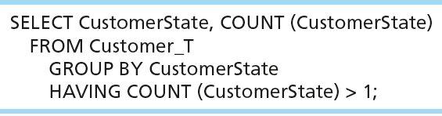
9.5. Qualifying results by categories using the Having Clause
For use with GROUP BY
Like a WHERE clause, but it operates on groups (categories), not on individual rows. Here, only those groups with total numbers greater than 1 will be included in final result.

Slide 31

Challenge Question
What does SQL stand for, and what is its purpose?
Explain the concept of a database and its importance in managing data.
What is the role of Data Definition Language (DDL) in SQL?
Explain the purpose of primary keys and how they are defined in SQL.

Slide 32
In Workshop
Questions & Answers
Practice Question on SQL

Slide 33
At the end…….
Now you are qualified for SQL!
Questions?

